Slide 1

STUDENT PERFORMANCE ANALYSIS

Slide 2
PRESENTED BY
Name : R.Siva Kumar
Reg No. : 23BCE9372

Slide 3
ABSTRACT
The Student Performance Analysis system is designed using Machine Learning techniques to analyze and improve student academic performance. The system collects student data such as marks and attendance, processes it, and generates meaningful insights through analysis and visualization. It uses Machine Learning algorithms such as Decision Tree or Logistic Regression to predict future student performance based on historical data. The application provides an easy-to-use interface for educators to monitor performance, identify weak students, and make informed decisions. Overall, the system enhances academic analysis by combining Machine Learning, data visualization, and predictive intelligence.
1

Slide 4
INTRODUCTION
In recent years, educational institutions have been generating a large amount of student-related data such as marks, attendance, and academic records. However, extracting meaningful insights from this data remains a major challenge.
To address this issue, our system provides an intelligent platform that analyzes student data and predicts future performance using Machine Learning techniques.
2

Slide 5
PROBLEM DEFINITION
Many educational institutions face challenges in analyzing student performance due to the absence of proper analytical tools and reliance on manual evaluation methods. It becomes difficult to identify weak students and understand performance trends effectively.
Additionally, the lack of Machine Learning-based approaches limits the ability to predict future academic outcomes. This results in delayed decision-making and reduces the effectiveness of academic improvements.
3

Slide 6
EXISTING SYSTEM
The existing system primarily relies on manual methods such as spreadsheets and traditional grading systems to evaluate student performance. These approaches require significant time and effort and are often prone to human errors.
Moreover, the current system does not support data visualization or predictive analysis, making it difficult for educators to identify performance patterns and make informed decisions.
4

Slide 7
PROPOSED SYSTEM
The proposed system is a web-based application designed to automate student performance analysis. It provides features such as secure user authentication, efficient data management, and graphical visualization to simplify the analysis process.
In addition, the system uses Machine Learning techniques to analyze historical data and predict future student performance. This helps educators make data-driven decisions and identify students who require additional support.
5

Slide 8

OBJECTIVES
The main objective of this project is to develop an automated system for analyzing student performance. It aims to identify weak and strong students, provide meaningful insights, and assist educators in improving academic outcomes through efficient data analysis.
6

Slide 9
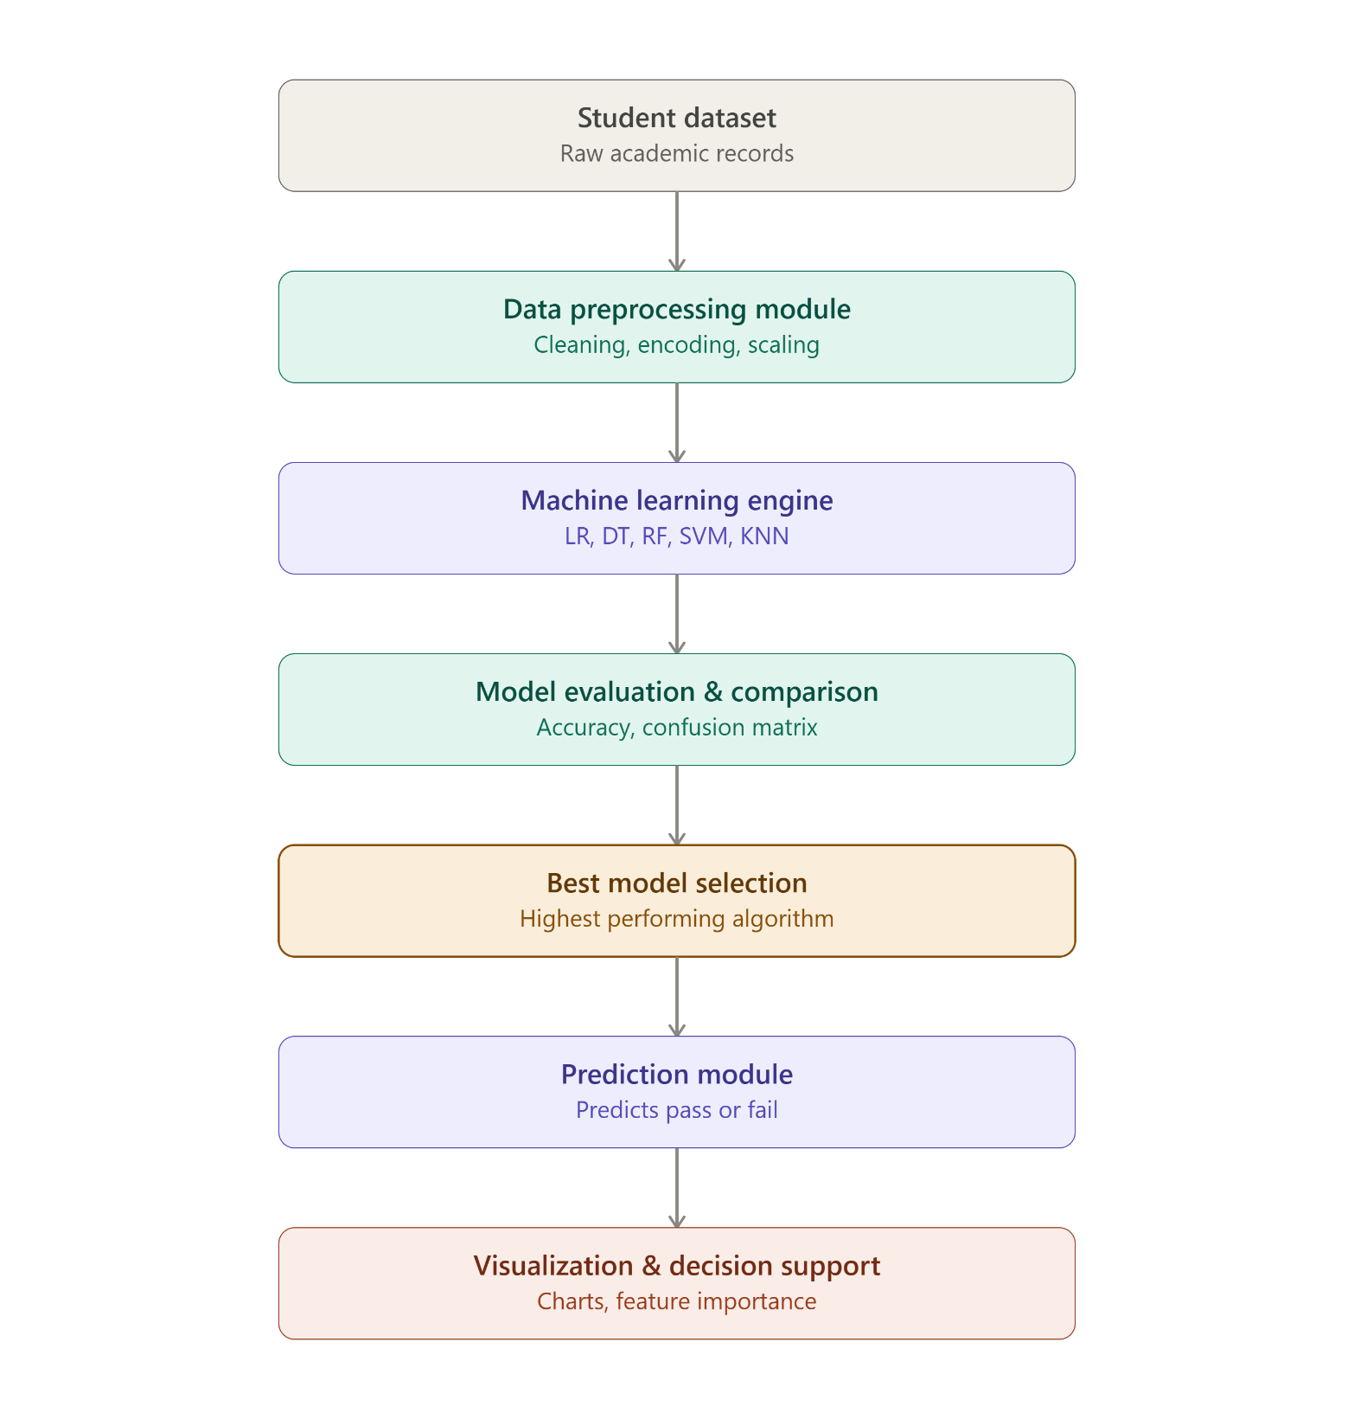
SYSTEM ARCHITECTURE
The system follows a three-tier architecture consisting of the presentation layer, application layer, and data layer. The presentation layer handles user interaction through the frontend, while the application layer processes data and performs Machine Learning-based analysis and prediction. The data layer stores student information such as marks and attendance, ensuring efficient data management and smooth system operation.
7

Slide 10
MODULES
User Module – User logs in securely using valid credentials.
Data Management Module – Student records are collected and stored.
Data Preprocessing Module – Data is cleaned, encoded, and scaled.
Analysis Module – Student performance trends are analyzed.
Prediction Module – Machine Learning predicts student performance.
Visualization Module – Results are displayed using graphs and charts.
Report Module – Performance reports are generated for decision-making.
8

Slide 11
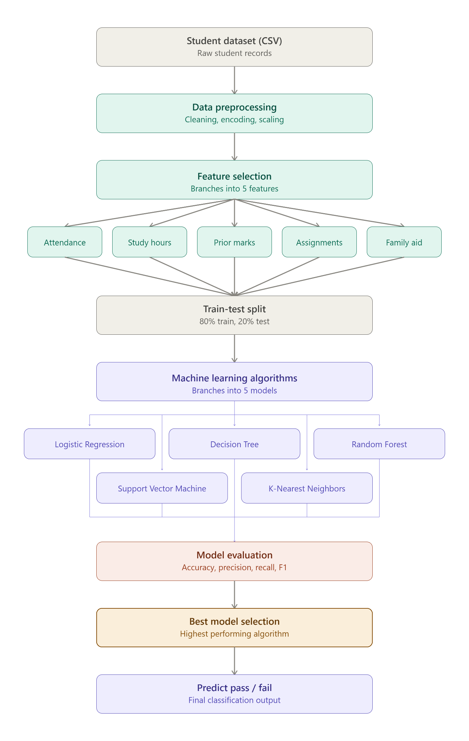
9

Slide 12
WORKFLOW
Load Student Dataset – Import student records (marks, attendance, study hours, etc.). Data Preprocessing – Clean, encode, and scale the data.
Train ML Models – Train Logistic Regression, Decision Tree, Random Forest, SVM, and KNN models.
Evaluate Models – Compare model performance and select the best model. Predict Performance – Predict whether a student will Pass or Fail.
Analyze Results – Identify student performance trends and weak areas.
Visualize & Generate Reports – Display results using graphs, charts, and performance reports.
10

Slide 13
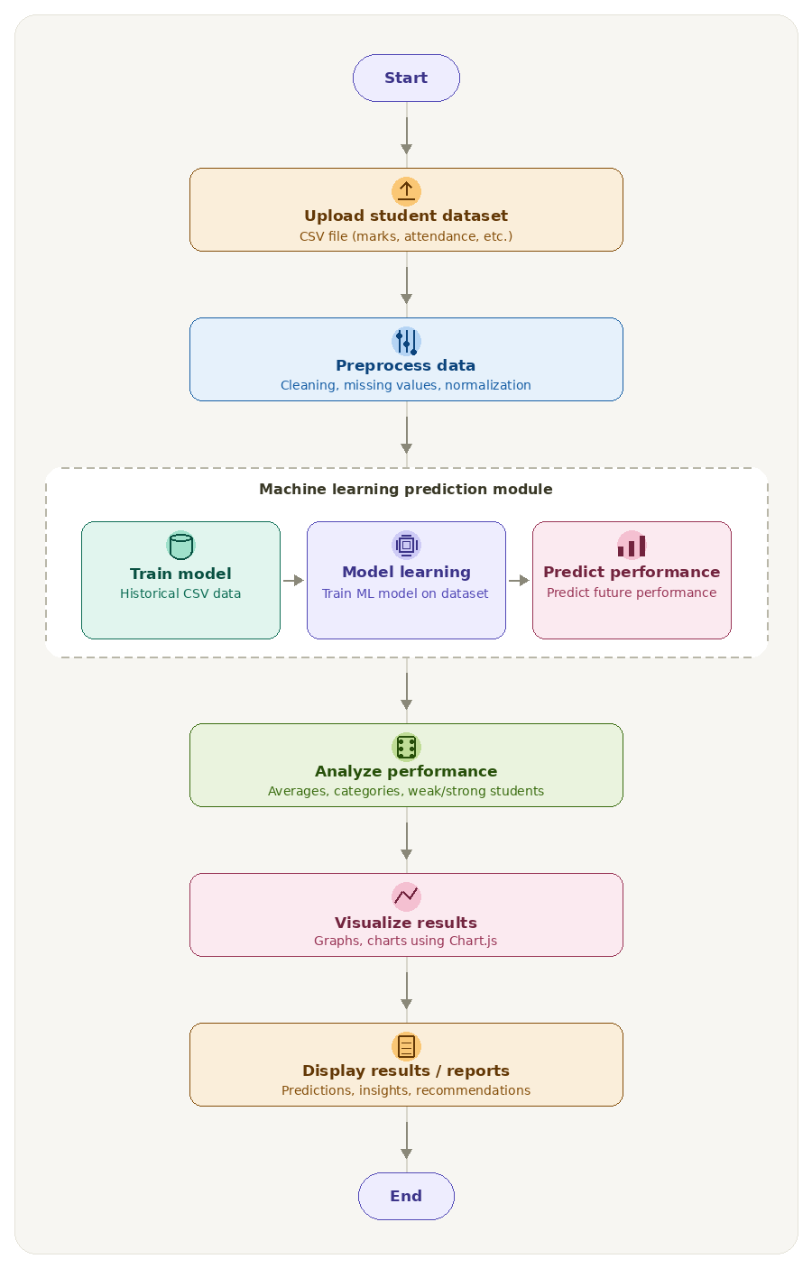
11

Slide 14
MODELS USED
Logistic Regression
Used for binary classification to predict pass/fail based on linear relationships.
Decision Tree
Used to model decisions through tree-like splits capturing non-linear patterns.
Random Forest
Used to improve accuracy by combining multiple decision trees and reducing overfitting.
SVM (Support Vector Machine)
Used to find the optimal boundary for separating classes in high-dimensional data.
KNN (K-Nearest Neighbors)
Used to classify based on similarity by analyzing nearest data points.
12

Slide 15
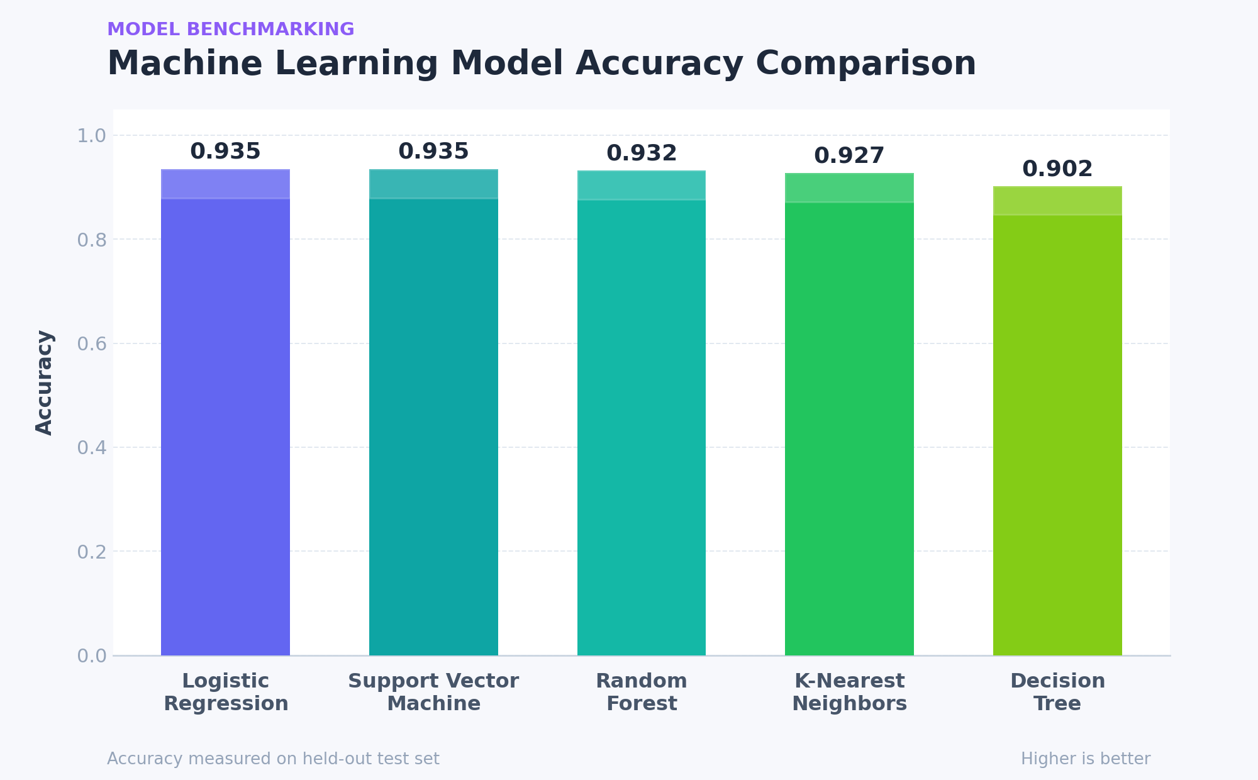
13

Slide 16
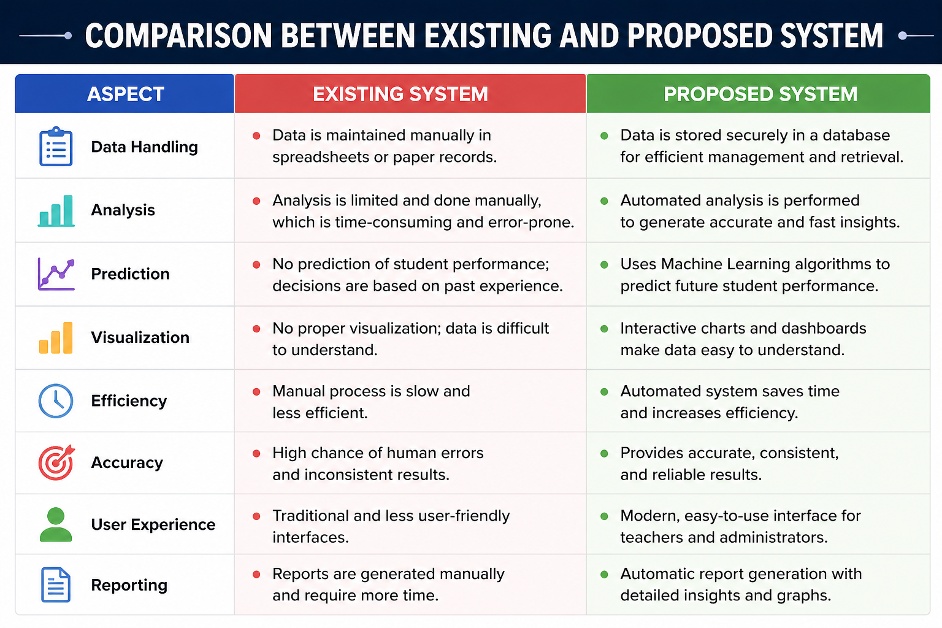
EXISTING VS PROPOSED
14

Slide 17
FUTURE SCOPE
Real-Time Data Analysis
Enable real-time monitoring of student performance using live data.
Mobile Application Development
Develop a mobile application for better accessibility and ease of use.
Personalized Recommendations(LLM)
Provide customized suggestions for students based on their performance.
Integration with Educational Platforms
Integrate the system with existing learning management systems.
Data Expansion
Include more features such as behavioral data and extracurricular activities.
Visualization Enhancements
Add advanced dashboards and interactive visualizations.
15

Slide 18

THANK YOU

